Slide 1
Writing Business e-mails

Slide 2
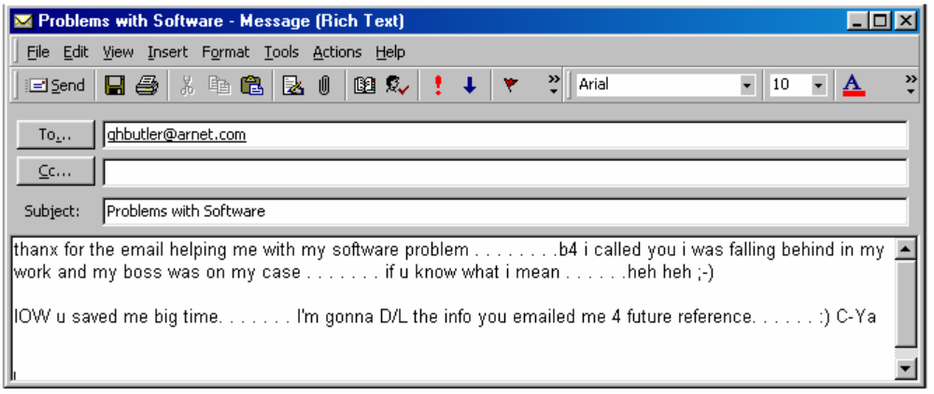
What is the Purpose of Business e-mails?
To electronically communicate work-related information and data in a formal and professional manner.
Casual emails are NOT business e-mails.
Notes:
IOW in other words D/L Download

Slide 3
What is the Purpose of Business e-mails?
Business e-mails can be used for:
- Memos (internal correspondence)
- Letters (external correspondence)
- Cover letters
- Suggestions/Requests
- Compliments
- Questions/Comments
- Complaints
- Rebates/Offers
- Subscriptions/Cancellations
- Reports, Data, Blueprints, Illustrations (as attachments)

Slide 4
What are Advantages of Business e-mails?
1. Quick: saves time
2. Economic: saves money
3. Convenient:
- Is used for internal and external correspondence
- Is sent and accessed from anywhere
- Reaches many people at the same time
- Is easy to archive and retrieve
Notes:
Handy and manageable

Slide 5
What are Disadvantages of Business e-mails?
1. Causes inaccurate communication, if proper tone is not used
(casual tone can create misunderstanding due to levels of
formality and lead to lack of professionalism)
2. Spreads personal/private information easily and dangerously
3. Consumes significant time at workplace, if not managed
4. Causes frustration to senders as they expect instant reply
to their emails

Slide 6
Proper Tone of Writing in Business e-mails:
Identify Your Readers
As a professional engineer, you will be required to communicate work-related issues associated with your position in organization to people above you, below low, and on your own level.
Your tone of writing (what you say and how you say it) must reflect your level of responsibility in organization or power relationships that exists between you and readers of your business e-mails.
Your business e-mails should demonstrate:
1. Subordinate tone when writing to readers in higher levels
2. Boss tone when writing to readers in lower levels
3. Colleague tone when writing to readers on your own level
Professional engineers should fit each business e-mail to its intended readers

Slide 7
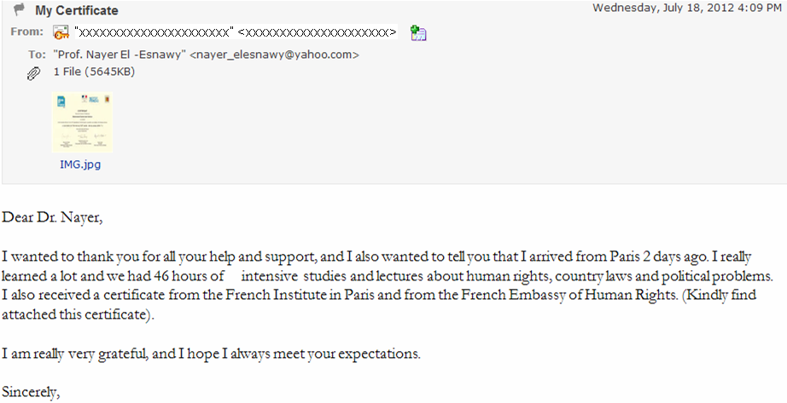
Proper Tone of Writing in Business e-mails:
Identify Your Readers
Proper tone of writing

Slide 8
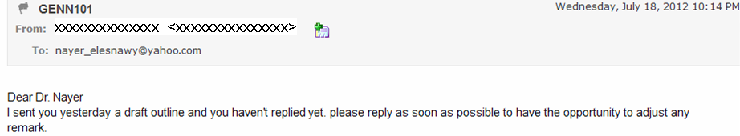
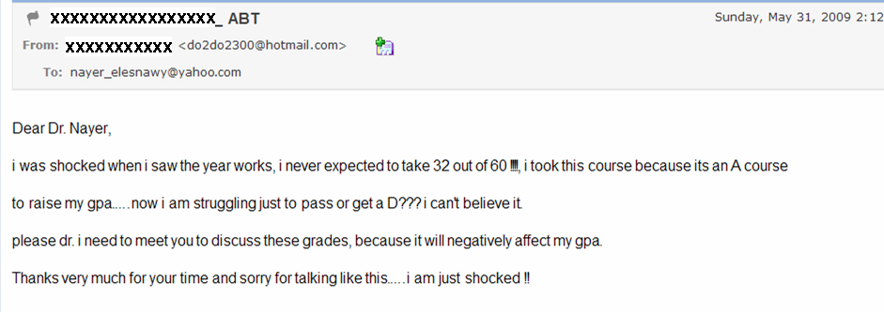
Proper Tone of Writing in Business e-mails:
Identify Your Readers
Improper tone of writing
Ugly tone of writing

Slide 9
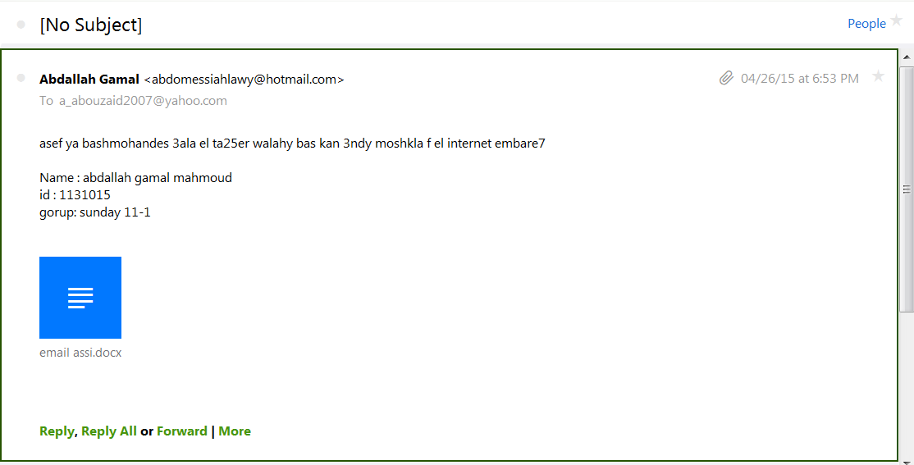
Proper Tone of Writing in Business e-mails:
Identify Your Readers
Improper tone of writing

Slide 10
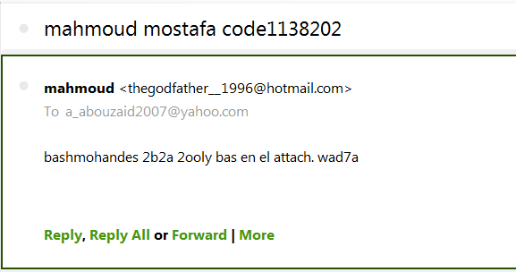
Proper Tone of Writing in Business e-mails:
Identify Your Readers
Improper tone of writing

Slide 11
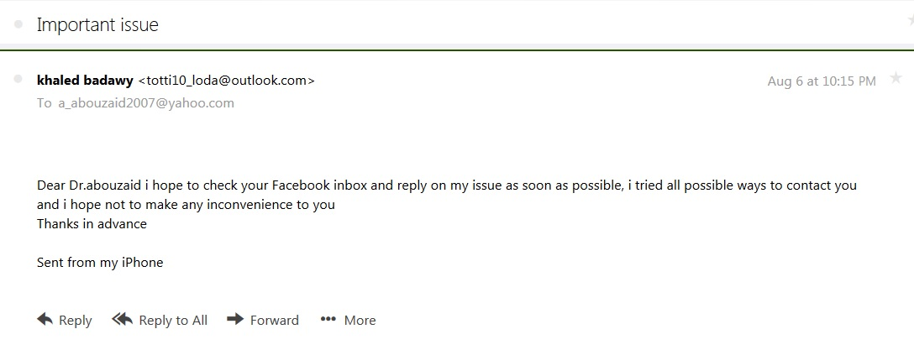
Proper Tone of Writing in Business e-mails:
Identify Your Readers
Improper tone of writing

Slide 12
Structure of Business e-mails
From: xxxxxxxxxxxxxxxxxxxxx
To: xxxxxxxxxxxxxxxxxxxxxxxx
Cc: xxxxxxxxxxxxxxxxxxxxxxxx
Bcc: xxxxxxxxxxxxxxxxxxxxxxx
Subject: xxxxxxxxxxxxxxxxxxxxx
Dear xxxxx:
Opening paragraph xxxxxxxxxxxxxx
xxxxxxxxxxxxxxxxxxxxxxxxxxxxxxxx
Middle paragraph(s) xxxxxxxxxxxxxxx
xxxxxxxxxxxxxxxxxxxxxxxxxxxxxxxxx
Closing paragraph xxxxxxxxxxxxxxxx
xxxxxxxxxxxxxxxxxxxxxxxxxxxxxxxxx
Sincerely,
Type your name xxxxx
*****************************
Ahmed S. Hassan
Petroleum Engineer
Gasco Company Limited
Cairo, Egypt
Tel (+2) 0111-111-1111
Email: xxxxxxxxxxxxxxx
Outgoing block (FROM)
Headings
- TO
- CC
- BCC
- Subject
Body (3 sections minimum)
- Greeting line + opening
- Discussion
- Closing
Signature block
Attachments

Slide 13
From: “Assem Imam” <assem_imam@gmail.com>
To: “Prof. Ali Al-Sayed” <a.sayed@eng.edu.cu.edu>
Subject: Requesting Information About SI System of Units
Dear Prof. Al-Sayed:
I am writing to request information about effective ways to teach people the International System of units (SI) for weights and measures. I am a junior student at the Faculty of Engineering of Cairo University. For a course in technical writing that I am taking this Fall semester, I am preparing a long formal report on the proper way to educate Egyptian students and engineers about the use of the SI. The report is due by the end of this Fall.
In the sources which I have been researching this topic concerning the SI measurements, you are frequently mentioned as a major authority in the field. Would you be kind enough to give me your opinion about how the SI system of units should be taught?
The specific aspect of preceding question that concerns me is whether the SI measurements should be taught in relation to present standard measurements, such as the ton, or whether they should be taught independently of other measurements. My research indicates that both methods are in use.
Any information you can provide to me about the SI measurements and how they should be taught in engineering colleges will be greatly appreciated. Of course, I will cite your contribution in my technical report. If convenient to you, I can be contacted by email at assem_imam@gmail.com. Thank you for your time and consideration.
Sincerely yours,
Assem Imam
**********************
Assem Ahmed Imam
Junior Student, Faculty of Engineering
Cairo University
Giza, Egypt
(+2) 0111-111-1111
assem_imam@gmail.com
Structure of Business e-mails
Notes:
Activities such as community services, student union, club activites

Slide 14
Structure of Business e-mails
Outgoing block (email address + outgoing name)
- Use a professional email address related to your name
- Use a professional outgoing name from you first + last
names; check spelling and capitalize first letter
From: “Outgoing Name” <email.address@yahoo.com>
From: “Ahmed Hassan” <ahassan@hotmail.com>
From: “Aya Ahmed” <aya.ahmed@gmail.com>
For email address and outgoing name, do NOT use:
- Nicknames
- Ambiguous names
- email address as your outgoing name

Slide 15
Structure of Business e-mails
Outgoing block (email address + outgoing name)
Improper examples:
“mohamed usama" <medousama2011@gmail.com>
“Mohamed anwer" <midomoon97@gmail.com>
“Mohamed anwer" <modydody09@hotmail.com>
“Youssef hatem" <astbx_yuze@yahoo.com>
“Mohamed Osama" <supermomo010101@gmail.com>
"karim akram" <thozer_kimo@hotmail.com>
“Ahmed El Taher” <goldahmed40@yahoo.com>
"miky nagy" <miky_miky6@yahoo.com>
"7ossam Faraj" <hossamhurricane@gmail.com>
"Mohamed A. MANSOUR" <midoferrari@hotmail.com>
"Abdelrahman Emad" <boody996@hotmail.com>

Slide 16
Structure of Business e-mails
Outgoing block (email address + outgoing name)
Improper examples:
"blaze devil" <blzdvl@hotmail.com>
"Ahmed Ccee" <ahmedccee@yahoo.com>
"medo Zabady" <theloverphaoro_90@hotmail.com>
"× моηтέε × ♥ ♥" <montythehector_hacker@hotmail.com>
"mahmoud bassri" <dookiekicksass@gmail.com>
"mahmoud" <thegodfather__1996@hotmail.com>"
"Mai ......." darkeyes_m@yahoo.com
"menna elgohary" manoon_5aled@hotmail.com
"Shady wageeh" <shidodido96@gmail.com>

Slide 17
Structure of Business e-mails
Outgoing block (email address + outgoing name)
Improper examples:
"Ahmed Mohamed" <real.zezo@gmail.com>
“Moustafa Abdullah" <tata12_2012@yahoo.com>
“Omar"Ahmed Mohamed" <real.zezo@gmail.com>
"Ahmed Mohamed" <real.zezo@gmail.com>
“Omar Samy” <omarmeessi32@gmail.com>
“Monica Roshdy” <monix373@gmail.com>
Yarayore55@yahoo.com
Osa_gemy96@yahoo.com
Captinayman10@gmail.com
Miroachraf@yahoo.com

Slide 18
Structure of Business e-mails
Headings (To, Cc, Bcc, Subject)
- To: type email(s) of main person(s) to whom you are sending
the email message to take required action (primary readers)
- Cc: type email(s) of secondary person(s) to whom you are
sending only a copy of the email message because of their
interest in matter, but they are not your primary readers
- Bcc: “blind Cc” to copy your email message to secondary
person(s) without anyone else knowing, e.g., to protect
their privacy. Be careful if you decide to use “Bcc”
- Subject: type topic of your email message
- Informative, clear, and concise (not too long or too short)
- No tricks; it should reflect content and its importance
- No abbreviations the writer does not know (clarity)

Slide 19
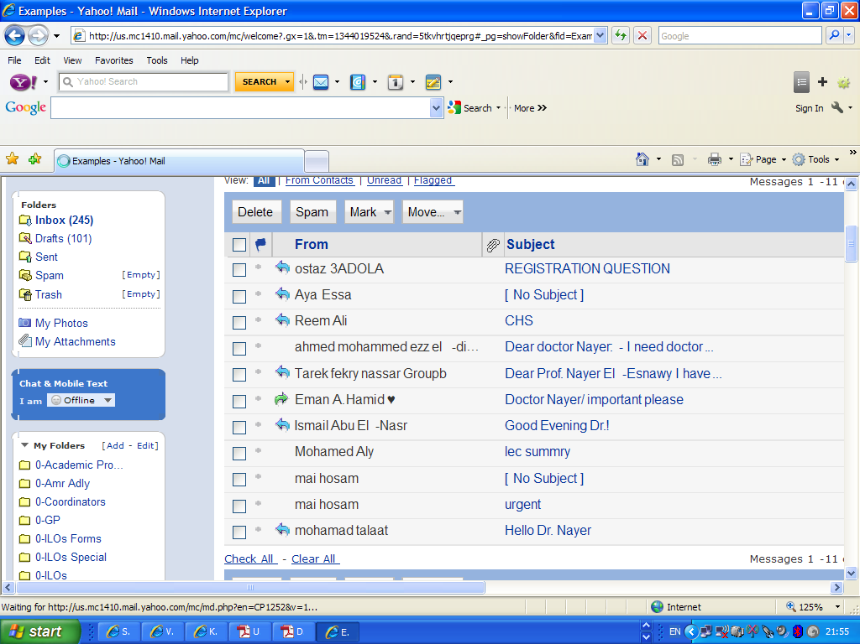
Structure of Business e-mails
Headings (To, Cc, Bcc, Subject)
For subject line, do NOT write:
- All capital letters
- Blank subject
(considered as spam or virus)
- Meaningless subject (hi, hello, important)
- Too many details

Slide 20
Structure of Business e-mails
Body: Greeting + Opening section
1. Greeting line: (Dear xxxxx:)
- For individuals, use specific names
- For non-colleagues and those at a higher position, use last
name of person preceded by a proper title:
“Dear Prof., Dr., Eng., Mr. (all men), Ms. (all women) xxx:”
- For colleagues and those at a lower position, you may use
the first name of person, “Dear Ahmed:”
- For group readers, use position titles (be polite and clever)
“Dear Esteemed Directors and Colleagues:”
- Type “ : ” at the end
- After exchanging several e-mails with the same person on the
same topic, you may drop the greeting line

Slide 21
Structure of Business e-mails
Body: Greeting + Opening section
2. Opening paragraph
- State purpose of your email message and its main points by
stating why are you writing and what are you writing about.
(Be clear, concise, and to the point)
- State in brief the action you request from the reader.
- Introduce yourself, if you are writing to someone you don’t
know
- Do not write long and/or vague openings.

Slide 22
Structure of Business e-mails
Body: Discussion sections
- Write short paragraphs
- State most important details of message that support your
main points (follow strategy of only need-to-know details)
- Use numbers, asterisks (*) & hyphens (-) for bullet listed,
items, if any, to organize your e-mail message.
(This will ease the reading of message by the readers.)
- Remember that most people will not read long e-mail
messages

Slide 23
Structure of Business e-mails
Body: Closing section
- Stress the action you need from the reader (be polite and
considerate)
- Provide your contact information for future communication.
(phone and/or email)
- Thank the reader for his/her time

Slide 24
Structure of Business e-mails
Signature block
- Type a complimentary phrase: Sincerely, Sincerely yours,
Yours sincerely, Respectfully, etc
- Type your common name
- Leave one blank line
- Type a short line of usual keyboard characters (*,-,#,^)
- Type your contact information similar to a business card:
your full name, title, organization and address, phone
number, email
To avoid typing your contact information at end of each e-mail message, prepare a signature file that automatically puts your stored contact information at the end of your email messages
Notes:
Activities such as community services, student union, club activites

Slide 25
Structure of Business e-mails
Attachments
- Handy tool to deliver documents, files, pictures, programs,
and data that your readers can download to their computers
- You should tell readers in body of your message that files are
attached; otherwise, they may not be noticed by the readers
- State type of attached file (pdf, doc, ppt, xls, rtf, etc).
- State in brief the purpose and content of attached file
- If several files are attached, use a list to tell readers, e.g.,
“ Please find attached are the following files:
1. A pdf file entitled xxxx that xxxxxxxxxxxxxxx
2. A document file entitled xxxx that xxxxxxxxx
3. A pdf file entitled xxxx that xxxxxxxxxxxxxxx ”
- If some details are too long, then they should be attached to
the email message – not typed inside the body
Notes:
Activities such as community services, student union, club activites

Slide 26
From: “Eng. Ahmed Hassan” <ahassan@hotmail.com>
To: “Amr Diab” <a.diab@gmail.com>, “Hoda Samy” <hodasamy@yahoo.com>
Cc: “Dr. Nayer El-Esnawy” <nayer_elesnawy@yahoo.com>
Subject: Timely Submission of Progress Project Reports
Dear Eng. Diab and Eng. Samy:
The monthly progress reports of your team have been one to two weeks late during the last three months. This late submission has affected the ability of our engineering division to inform the head office about the advancement and problems of our projects in due time. Starting from next month, the progress reports of your team about the ND project should be submitted to our division by the second work day of each month.
As discussed in the quarterly meetings of our division, the submission of progress reports for our projects is a standard requirement for all team leaders. These reports provide critical information for tracking progress and problems of each project. When the progress reports of one team are missing or tardy, the status of the division’s efforts is affected. Therefore, all team leaders should:
1. Prepare their progress reports according to the division’s format, as shown by the attached
template document entitled “PRTForm.docx”.
2. Submit their progress reports by the end of the fourth work day of each month.
Please see that your monthly progress reports are submitted by noon of the second work day of each month. Your cooperation is required and appreciated. If you have any inquiries, feel free to contact me by phone or by email.
Sincerely,
Ahmed Hassan
**********************
Ahmed S. Hassan, Petroleum Engineer
GASCO Company Limited
Cairo, Egypt
(+2) 0111-111-1111
ahassan@hotmail.com
Structure of Business e-mails
Notes:
Activities such as community services, student union, club activites

Slide 27
From: “Eng. Ahmed Hassan” <ahassan@hotmail.com>
To: custservice@gulftauto.com.eg
Subject: Defective Product Purchased From Your Dealership
Dear Gulf Auto Representative:
Last week, I purchased two shock absorbers from your automotive dealership in Alexandria. One of those two shock absorbers has since proved defective. It is causing expensive damage to the tire and the suspension system, and, therefore, it should be replaced. For your convenience, I am attaching scanned copies of the receipt (receipt,jpg) and the warranty for that purchase (warranty.jpg).
I tried to exchange the defective shock at the dealership yesterday. The mechanic on duty, Ahmed Sameh, informed me that the warranty was invalid because the defective shock was not installed by the service staff of Gulf Auto. I am complaining that your dealership did not honor the warranty agreement and replace the defective part because of the following reasons:
* The warranty states that the shock absorber is covered for 48 months and 48,000 miles
* The warranty does not state that installation should be done by the staff of Gulf Auto
* The warranty does not state that it will become invalid if someone else installs the shock
I request that the warranty should be respected and that the defective shock absorber should be replaced by your dealership. Please inform me about the arrangement to exchange my defective shock in a timely manner. I can be reached between 10:00 am and 5:00 pm on weekdays at (+2) 0111-111-1111. I look forward to your response. Thank you for your time and cooperation to resolve this misunderstanding.
Sincerely,
Ahmed Hassan
**********************
Ahmed S. Hassan, Petroleum Engineer
GASCO Company Limited
Cairo, Egypt
(+2) 0111-111-1111
ahassan@hotmail.com
Structure of Business e-mails
Notes:
Activities such as community services, student union, club activites

Slide 28
Etiquette of Business e-mails: Netiquette
Use “To:” , “Cc:” , and “Bcc:” headings properly.
Write only one topic in each e-mail message
Always check the correctness of your language before you hit ‘send’. Errors will hurt your professional image.
Avoid typing words and/or phrases in CAPS as this is perceived as SHOUTING.
Avoid humor or jokes in business e-mails, even if you and the receiver are friends.
Avoid personal, private, and/or copyrighted information in your business e-mails as they can be forwarded to many people.
Avoid e-mail abbreviations unless you are sure that your readers are aware of them.

Slide 29
Etiquette of Business e-mails: Netiquette
Avoid adding a Post Script (PS) after you close your e-mail. It may go unnoticed, and it shows that you are not well-organized.
Avoid casual writing, e.g., lowercase pronouns “i”, using ellipses (…) and dashes instead of proper punctuation, using emoticons, using shorthand language, using English letters to write Arabic phrases, etc
Avoid flaming (sending angry emails or negative correspondence)
- Avoid replying when you are angry; once you hit ‘send’, you
can not get your words back
- Avoid typing words and/or phrases in CAPS
- Avoid letting instantaneous quality of e-mail negate your need
to be calm, cool, deliberate, and professional
- Avoid escalating negative or improper correspondence

Slide 30
Etiquette of Business e-mails: Netiquette
When replying to e-mail messages:
- Be careful with the option ‘reply all’. Don’t use it unless you want
to send your reply to the whole list: the sender as well as her/his
primary readers (To) and secondary readers (Cc)
- If the sender asks questions, you may list the questions in
your reply and provide your answer after each question
- After exchanging several e-mails with same person on same
topic, you may not include original message from sender in your
reply. (After few exchanges, emails become very long and irritating)

Slide 31
Etiquette of Business e-mails: Netiquette
When forwarding e-mail messages:
- Avoid forwarding e-mails that may have personal/private issues
- Do not forget to protect the identity of original sender if necessary,
by deleting her/his email address and outgoing name before you
forward the email
- Avoid sending a silent forwarded message; you should write
short paragraph(s) to introduce and explain forwarded message

